Slide 1
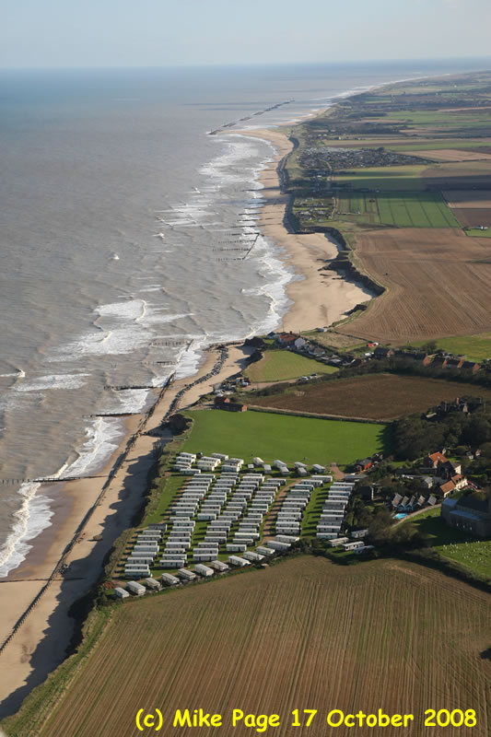
GCSE Geography Virtual Fieldcourse:- The Norfolk Coast
A Comparison of Coastal Management Strategies on the Norfolk Coast

Slide 2
Two sites were chosen on the North Norfolk coast:- Sea Palling and Happisburgh
(Happisburgh is pronounced Hazeborough)
Happisburgh
Sea Palling
The places were chosen because different forms of management have been used to prevent erosion of the coastline.
In both places the impact of erosion would be very different.

Slide 3
N
Happisburgh is 5.6km along the coast from Sea Palling

Slide 4
Sea Palling
Look carefully to see how most of the land is used
Happisburgh

Slide 5
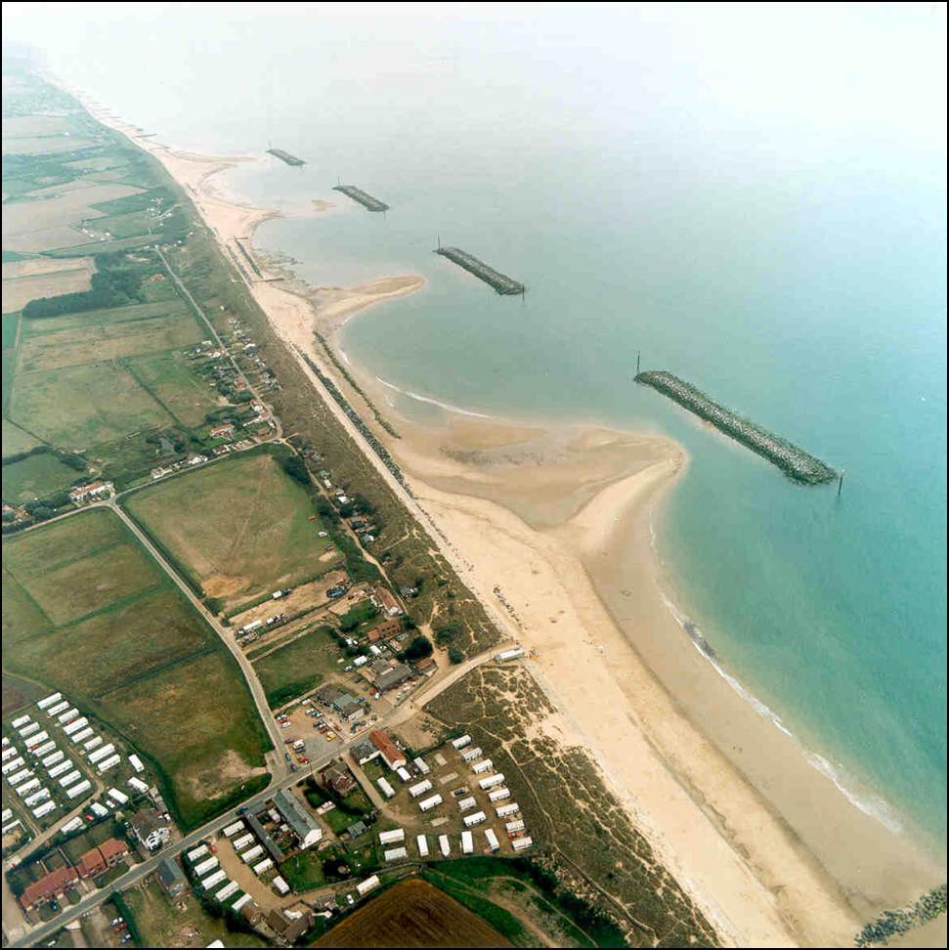
Fieldwork Location 1
Sea Palling

Slide 6
Fieldwork Location 1
Sea Palling:- Background Information
Erosion has always happened at Sea Palling
A lack of maintenance meant that the sand dunes were often breached by the sea.
In the 19th century a programme of sea defence work was started.

Slide 7
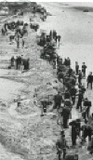
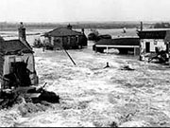
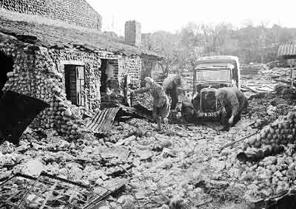
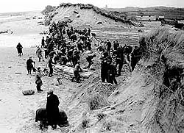
Fieldwork Location 1
Sea Palling:- Background Information
Severe floods by the North Sea drowned seven villagers in 1953

Slide 8
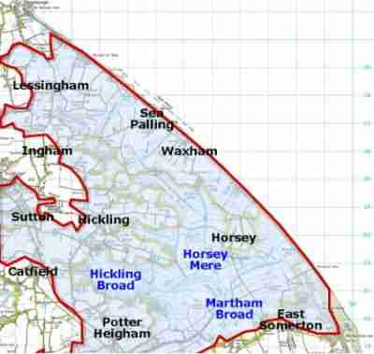
Fieldwork Location 1
Sea Palling:- Background Information
It was thought that if another serious flood was to occur it would cover a large part of Norfolk.
Large areas of top quality farmland would be flooded and parts of the Norfolk Broads would be destroyed

Slide 9
Fieldwork Location 1
Sea Palling:- Background Information
The sea wall was extended in 1986.
In 1995 the Environment Agency started the multi-million pound project of building nine offshore bars.

Slide 10
A Comparison of Coastal Management Strategies on the Norfolk Coast
Sea Palling:- Task 1
The following 3 slides show images of Sea Palling. Look at them carefully and use the information to complete Question 1 on page 2 of your booklet.
Sea Palling village
Land below sea level
Sand dune
Beach
Holiday cottages

Slide 11
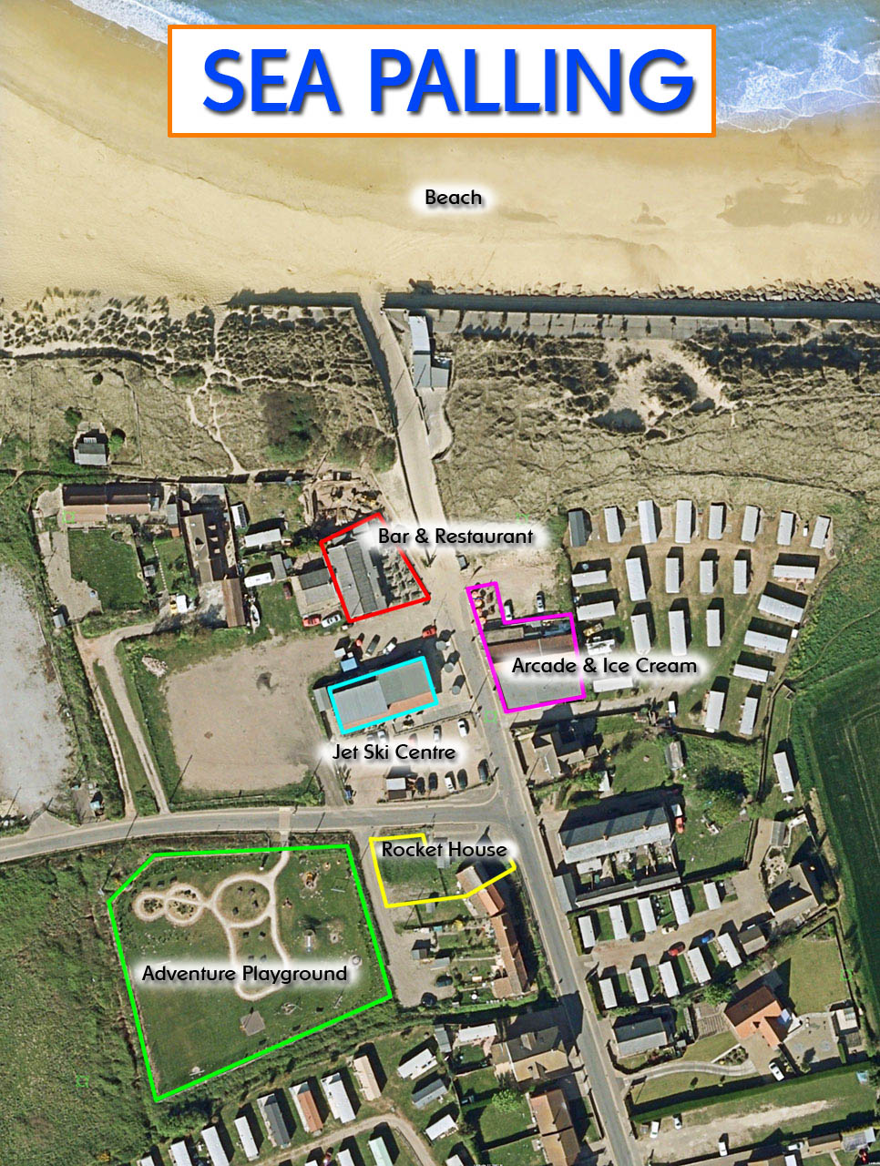
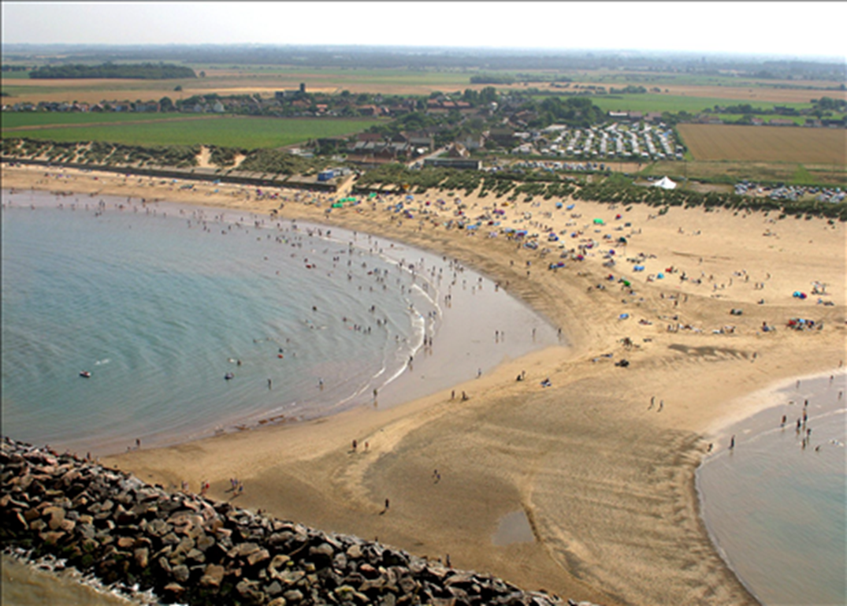
A Comparison of Coastal Management Strategies on the Norfolk Coast
Sea Palling:- Task 1

Slide 12
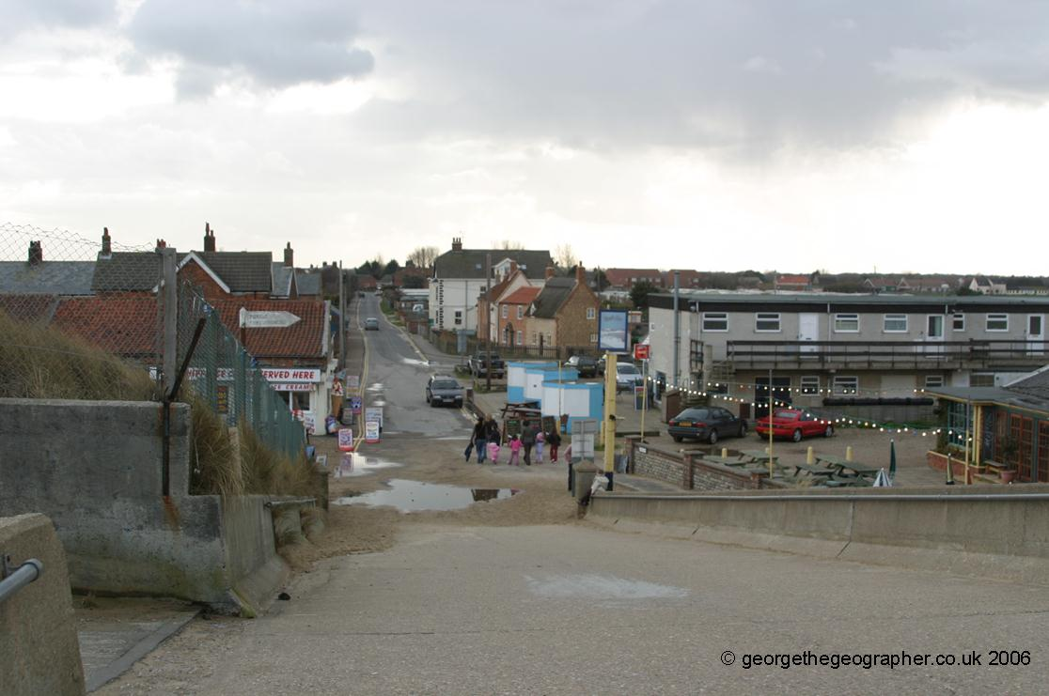
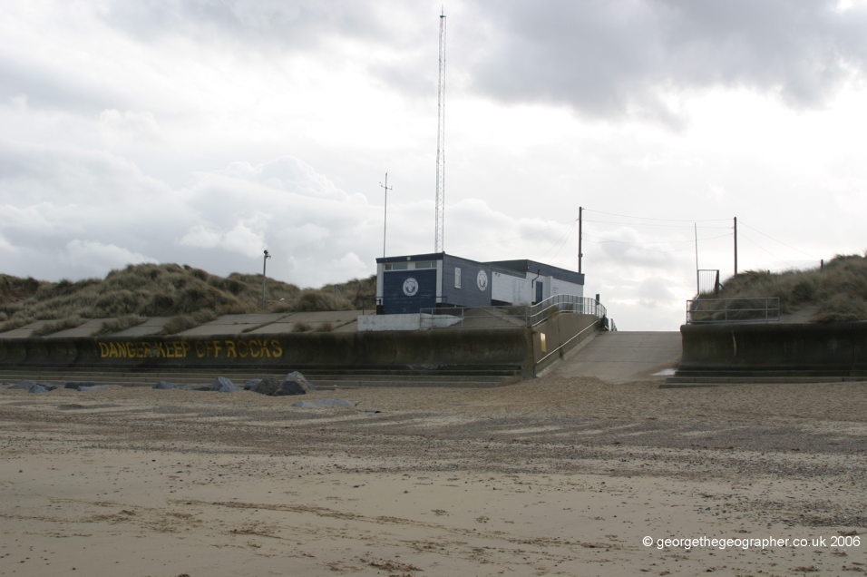
A Comparison of Coastal Management Strategies on the Norfolk Coast
Sea Palling:- Task 1

Slide 13
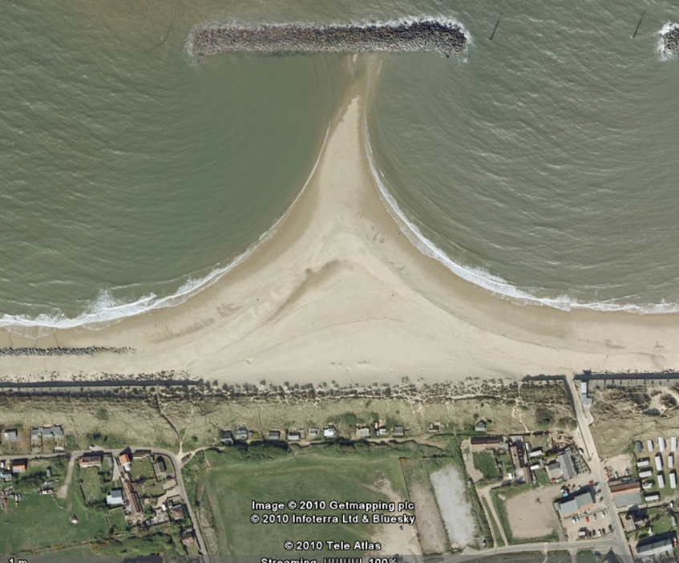
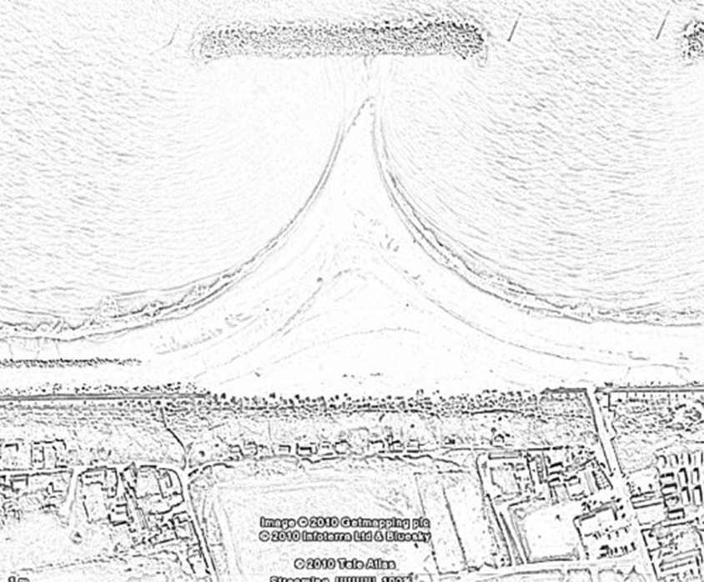
A Comparison of Coastal Management Strategies on the Norfolk Coast
Sea Palling:- Task 2
On page 3 of your booklet you will find a sketch of an aerial view of the coast at Sea Palling.
You will see pictures taken at different points in the area. On your sketch, add labels and annotations to describe the different types of management that has taken place

Slide 14
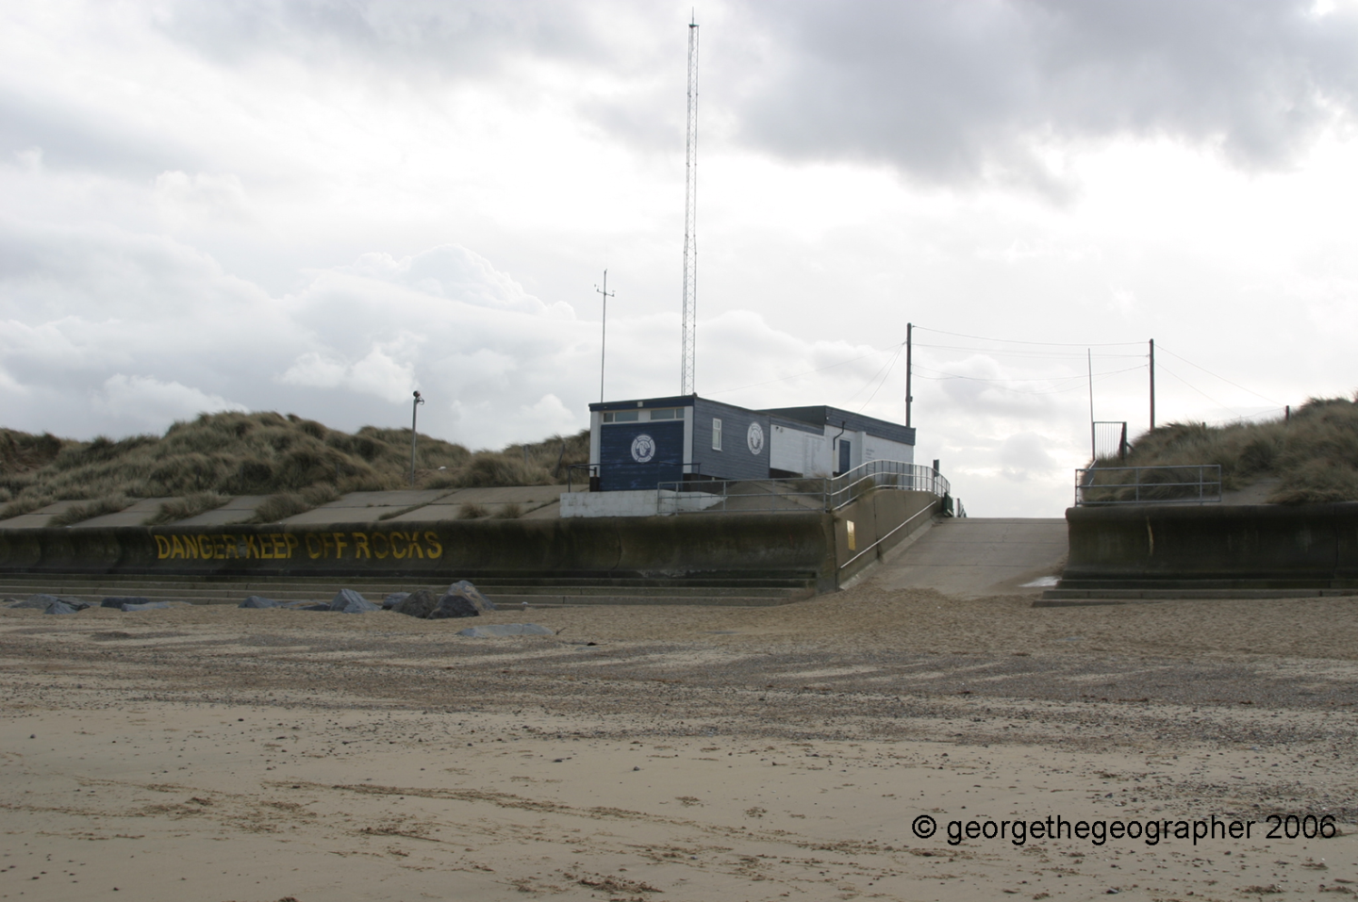
A Comparison of Coastal Management Strategies on the Norfolk Coast
Sea Palling:- Task 2
You will see pictures taken at different points in the area. On your sketch, add labels and annotations to describe the different types of management that has taken place
1

Slide 15
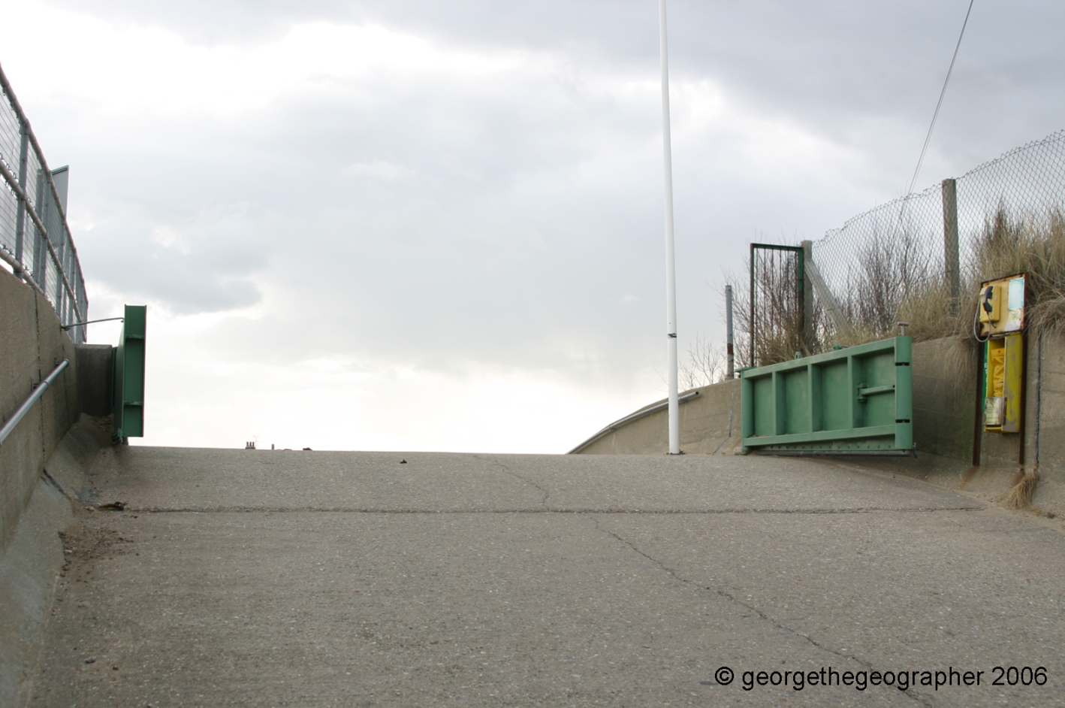
A Comparison of Coastal Management Strategies on the Norfolk Coast
Sea Palling:- Task 2
You will see pictures taken at different points in the area. On your sketch, add labels and annotations to describe the different types of management that has taken place
This roadway allows access to the beach from the village. If there is a risk of flooding the gates can be closed to stop the water.
2

Slide 16
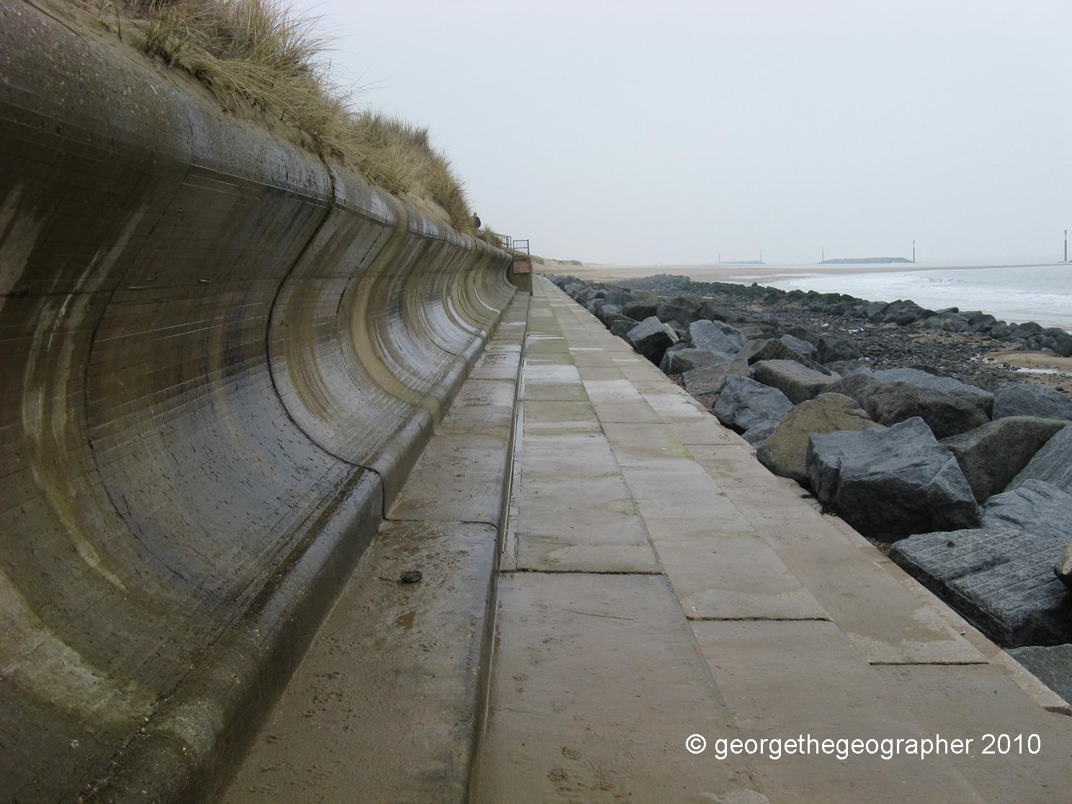
A Comparison of Coastal Management Strategies on the Norfolk Coast
Sea Palling:- Task 2
You will see pictures taken at different points in the area. On your sketch, add labels and annotations to describe the different types of management that has taken place
3

Slide 17
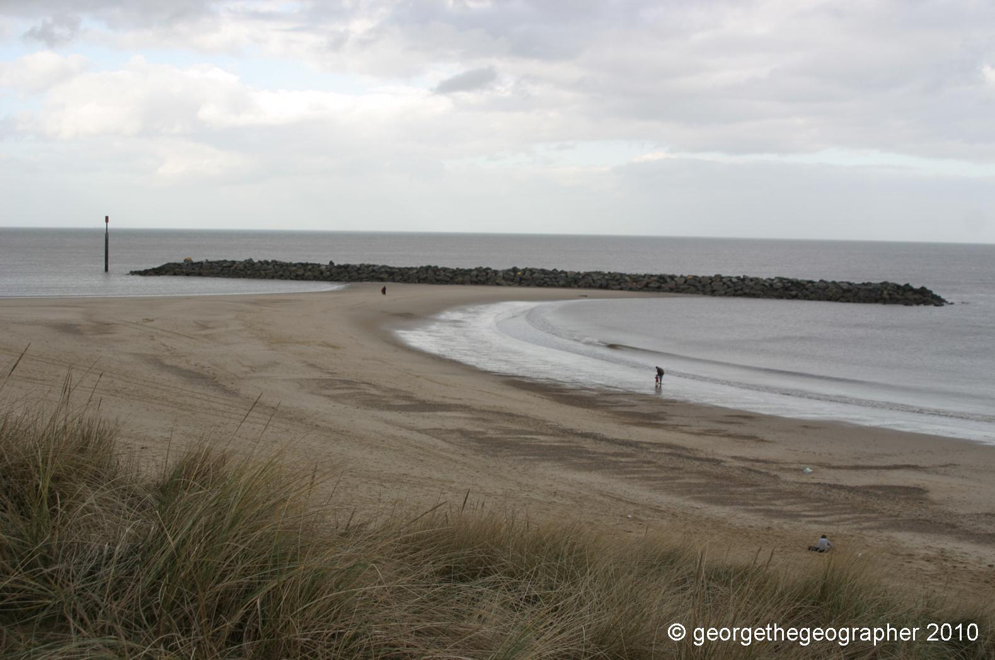
A Comparison of Coastal Management Strategies on the Norfolk Coast
Sea Palling:- Task 2
You will see pictures taken at different points in the area. On your sketch, add labels and annotations to describe the different types of management that has taken place
4

Slide 18
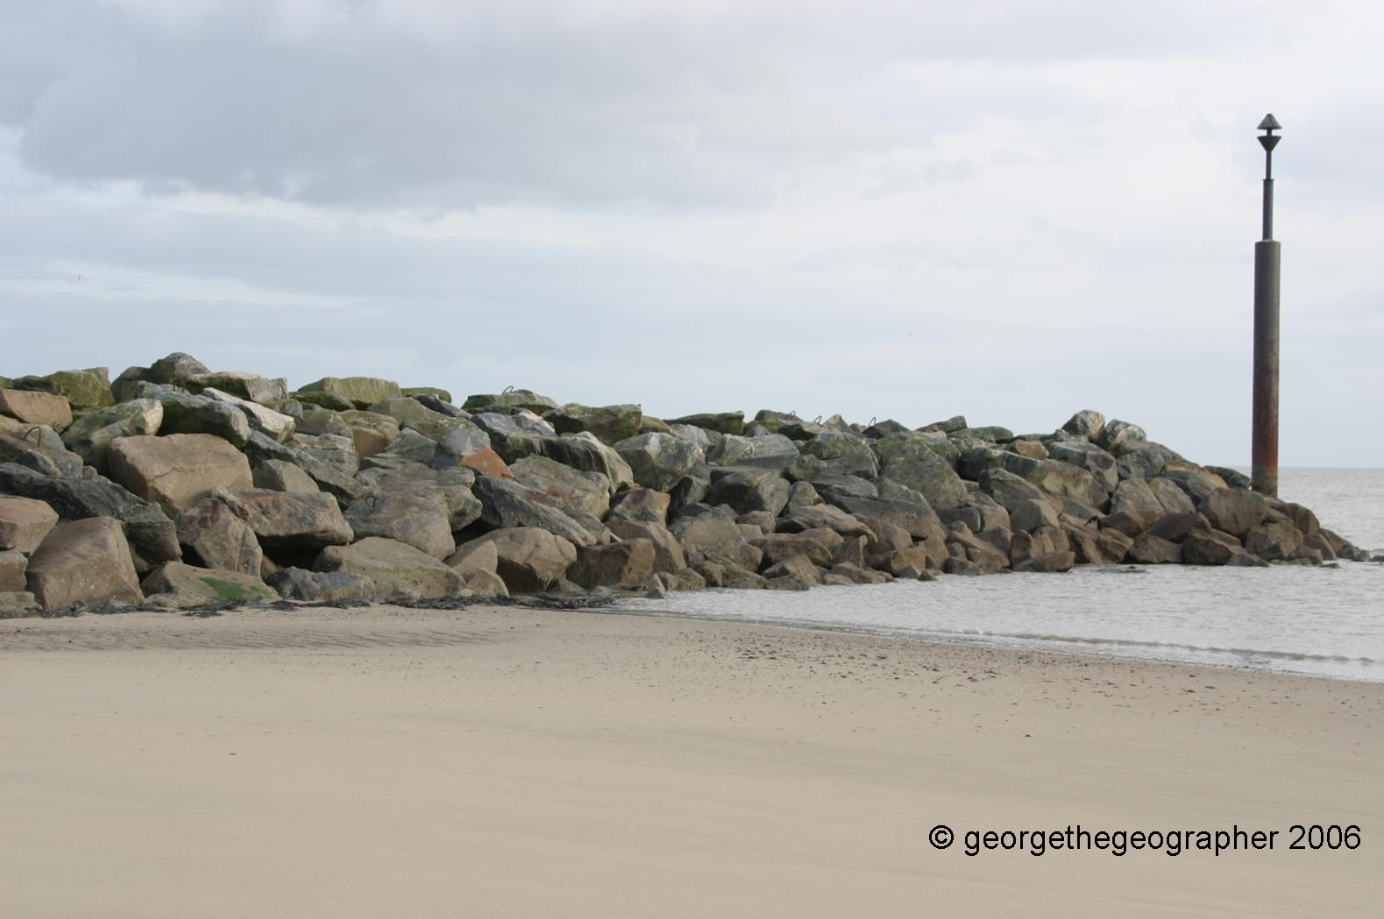
A Comparison of Coastal Management Strategies on the Norfolk Coast
Sea Palling:- Task 2
You will see pictures taken at different points in the area. On your sketch, add labels and annotations to describe the different types of management that has taken place
5

Slide 19
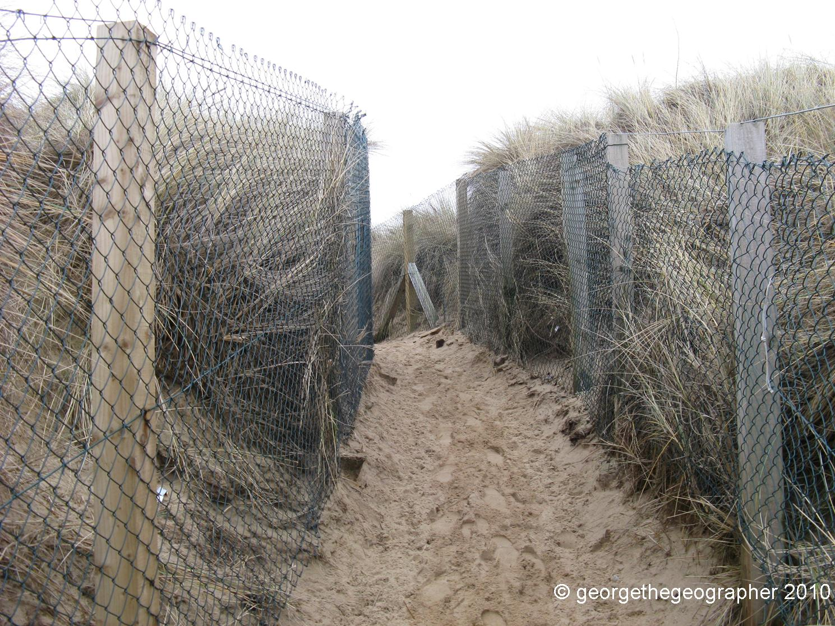
A Comparison of Coastal Management Strategies on the Norfolk Coast
Sea Palling:- Task 2
You will see pictures taken at different points in the area. On your sketch, add labels and annotations to describe the different types of management that has taken place
6

Slide 20
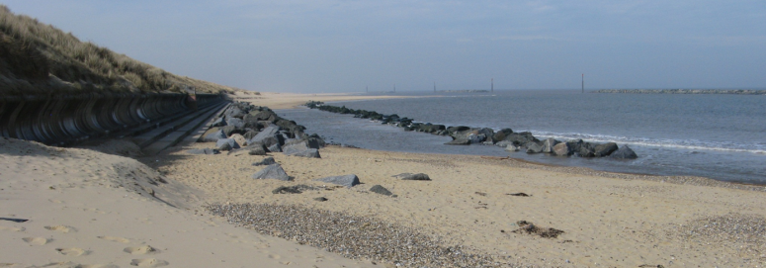
Fieldwork Location 1
Sea Palling:- Task 3
Complete Question 2 on page 2 of your booklet by describing all the different types of management that has been used at Sea Palling.
Try to include what you think was the aim of the coastal management – why did they do it?

Slide 21
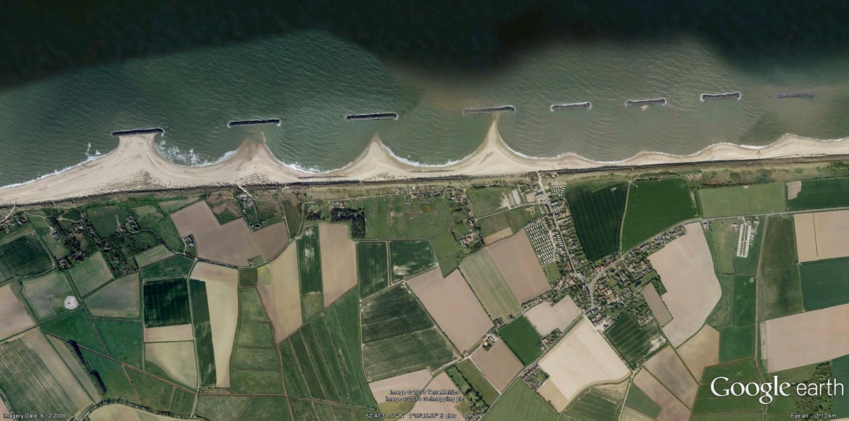
Fieldwork Location 1
Sea Palling:- Task 4
Has the management strategy been a success or failure?
Complete Question 4 on page 4 of your booklet to help you make a decision.

Slide 22
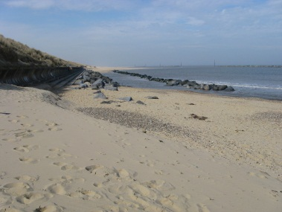
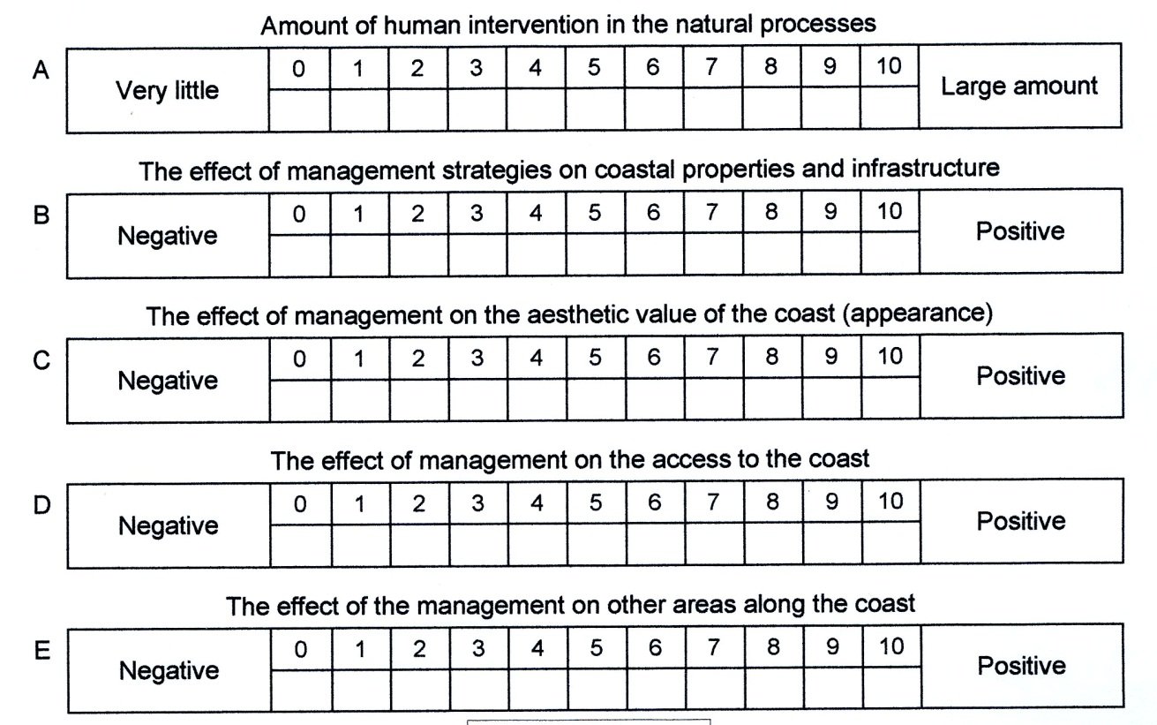
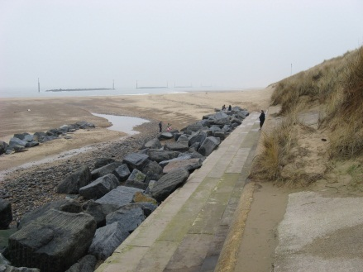
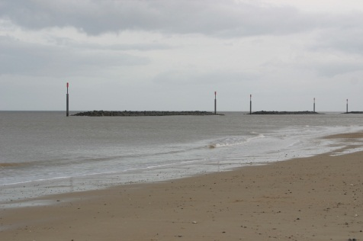
Fieldwork Location 1
Sea Palling:- Task 5
Another way of deciding how effective the management has been, is to evaluate what sort of impact it has had on the environment.
Using all the evidence you have seen, complete the following table which you will find in Question 5 on page 4 of your booklet.

Slide 23
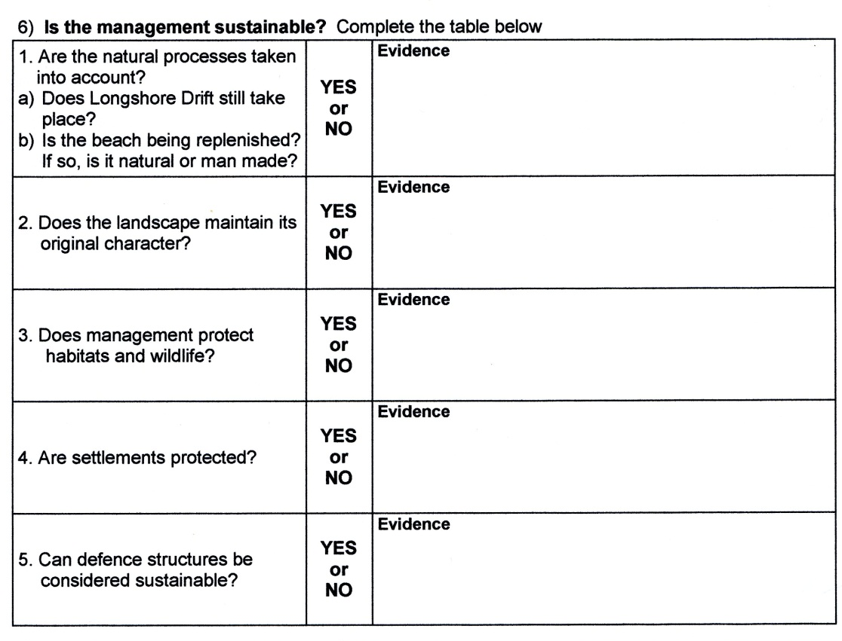
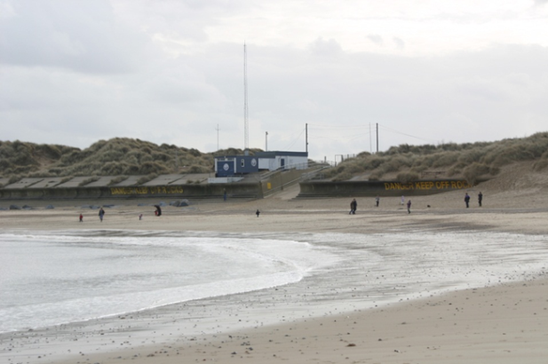
Fieldwork Location 1
Sea Palling:- Task 6
The effectiveness can also be evaluated by looking to see if the management is sustainable. Sustainable management would be successful but have minimum negative impact on the environment.
Using all the evidence you have seen, complete the following table which you will find in Question 6 on page 5 of your booklet.

Slide 24
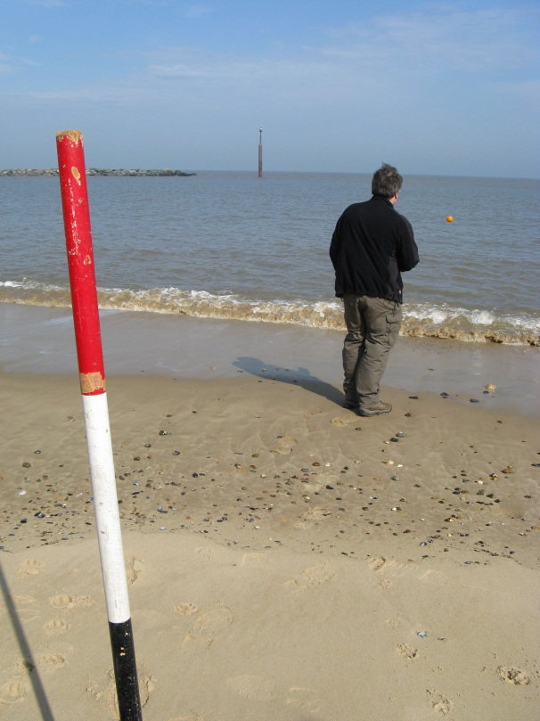
Fieldwork Location 1
Sea Palling:- Tasks 7 & 8
Evidence of longshore drift and description of the waves
Question 7 on page 5 of the booklet.
This requires a highly skilled geographer using some high-tech equipment!
A float was thrown into the sea and timed for ten minutes to see how far it moved due to longshore drift.
RESULT - 5.4 metres. Direction = North West
Question 8
There were less than 13 waves in a minute.
Use the picture on the left to decide the height of the waves and how the waves break onto the beach.

Slide 25
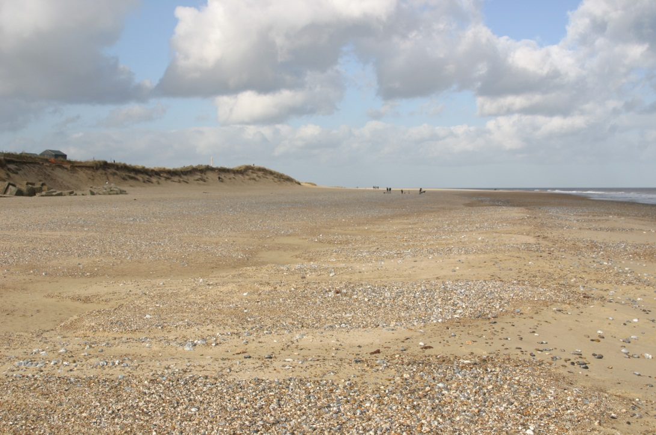
Fieldwork Location 1
Sea Palling:- Task 9
Question 9 on page 5 of the booklet.
Study the pictures below and complete the table.

Slide 26
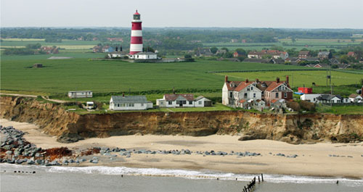
A Comparison of Coastal Management Strategies on the Norfolk Coast
Happisburgh

Slide 27
A Comparison of Coastal Management Strategies on the Norfolk Coast
Happisburgh:- Background information
There has been a long history of coastal erosion at Happisburgh

Slide 28
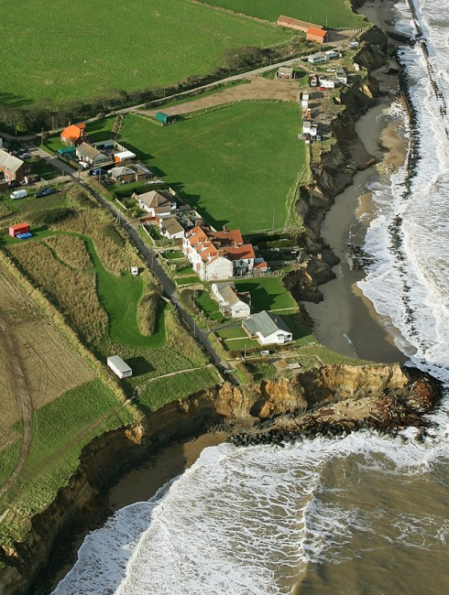
A Comparison of Coastal Management Strategies on the Norfolk Coast
Happisburgh:- Background information
Most of the village lies a little distance inland. However, some properties were right on the cliff edge in 2012.
A timber revetment was built in 1959 to help protect the area

Slide 29
GCSE Geography Virtual Fieldcourse:- The Norfolk Coast
A Comparison of Coastal Management Strategies on the Norfolk Coast
Happisburgh:- Fieldwork
Identical fieldwork to that done at Sea Palling will be carried out at Happisburgh.
Make sure you write the results in the correct booklet.

Slide 30
GCSE Geography Virtual Fieldcourse:- The Norfolk Coast
A Comparison of Coastal Management Strategies on the Norfolk Coast
Happisburgh:- Task 1
The following 3 slides show images of Happisburgh. Look at them carefully and use the information to complete Question 1 on page 2 of your Happisburgh booklet.

Slide 31
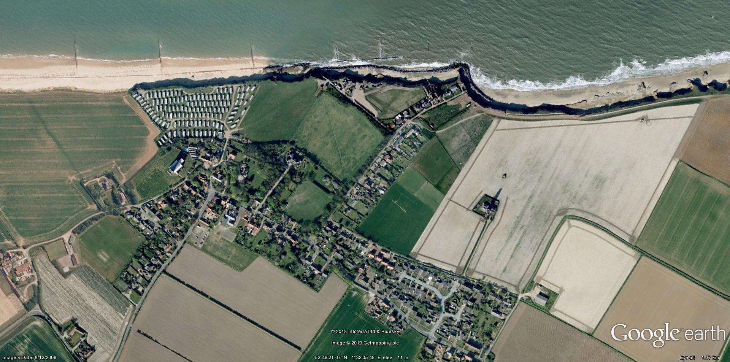
GCSE Geography Virtual Fieldcourse:- The Norfolk Coast
A Comparison of Coastal Management Strategies on the Norfolk Coast
Happisburgh:- Task 1

Slide 32
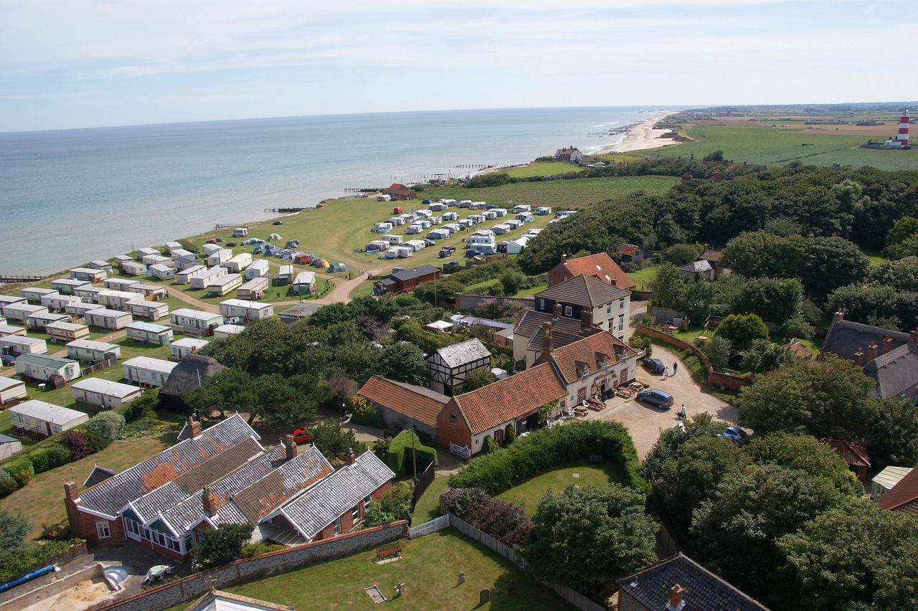
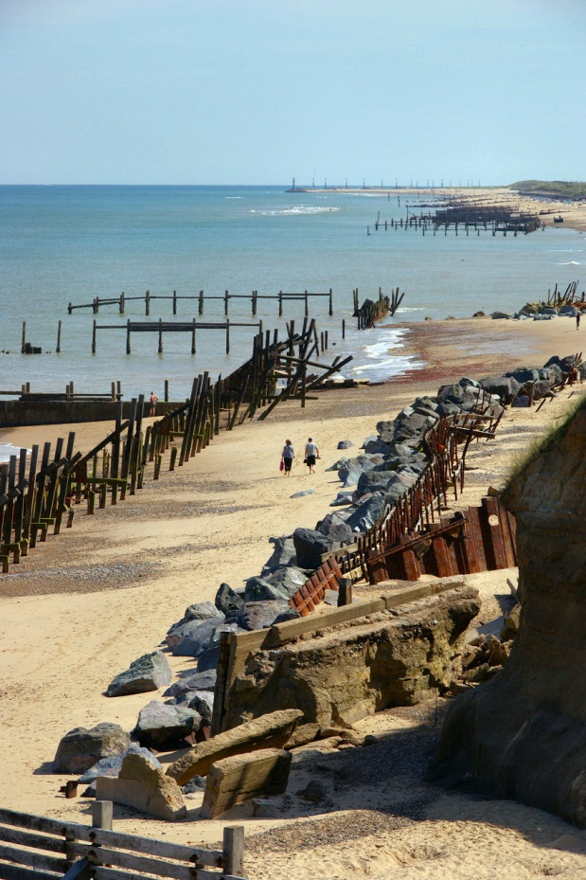
GCSE Geography Virtual Fieldcourse:- The Norfolk Coast
A Comparison of Coastal Management Strategies on the Norfolk Coast
Happisburgh:- Task 1

Slide 33
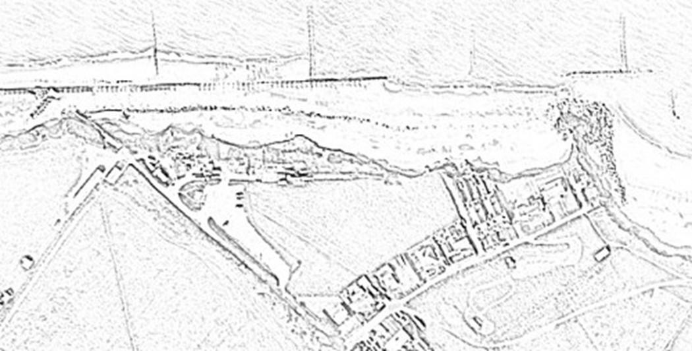
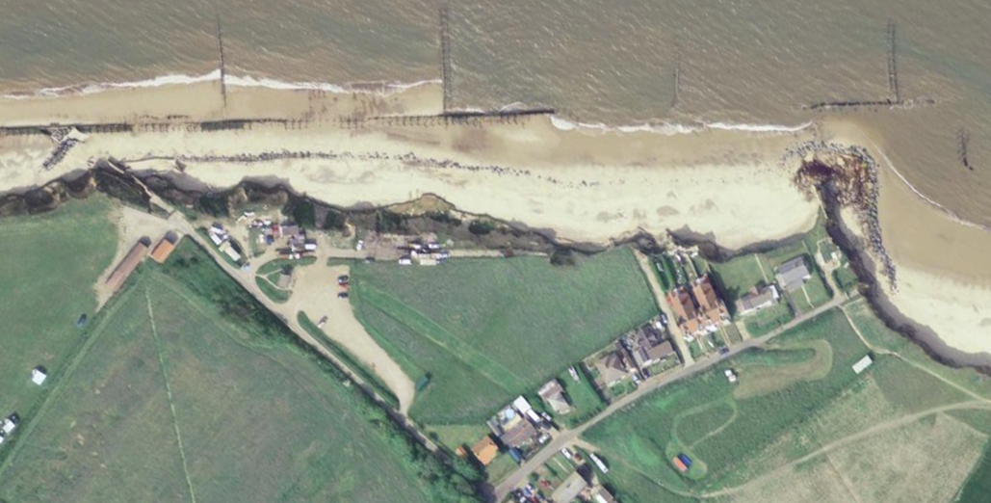
GCSE Geography Virtual Fieldcourse:- The Norfolk Coast
A Comparison of Coastal Management Strategies on the Norfolk Coast
Happisburgh:- Task 2
On page 3 of your booklet you will find a sketch of an aerial view of the coast at Happisburgh.
You will see pictures taken at different points in the area. On your sketch, add labels and annotations to describe the different types of management that has taken place

Slide 34
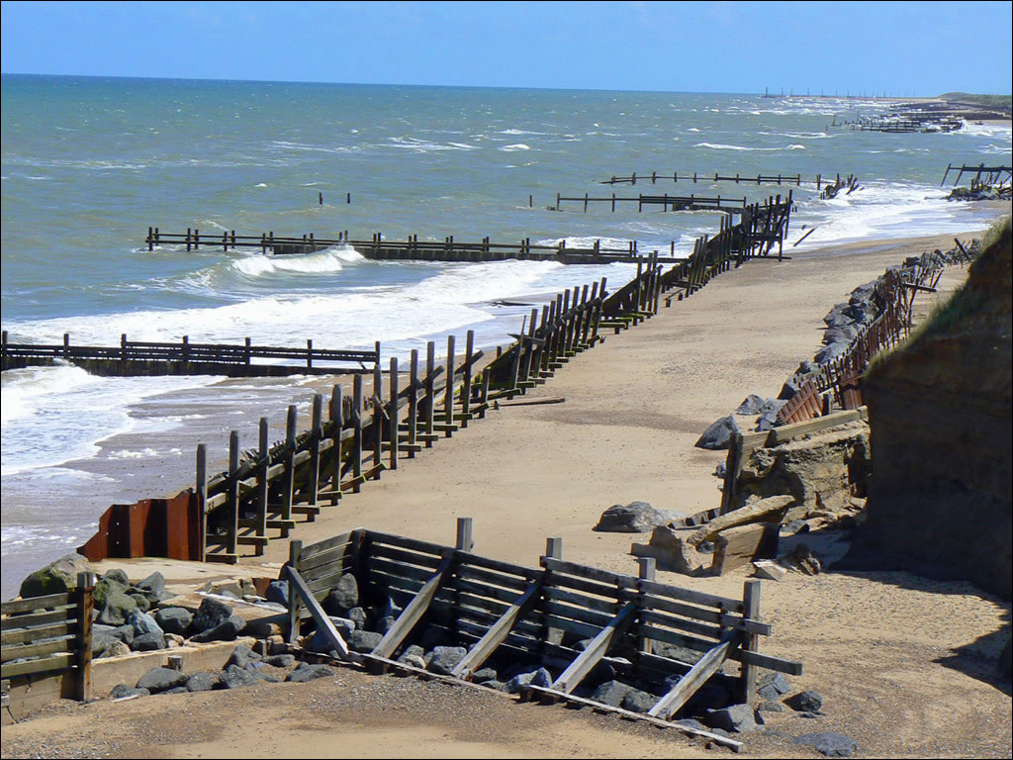
GCSE Geography Virtual Fieldcourse:- The Norfolk Coast
A Comparison of Coastal Management Strategies on the Norfolk Coast
Happisburgh:- Task 2
1

Slide 35
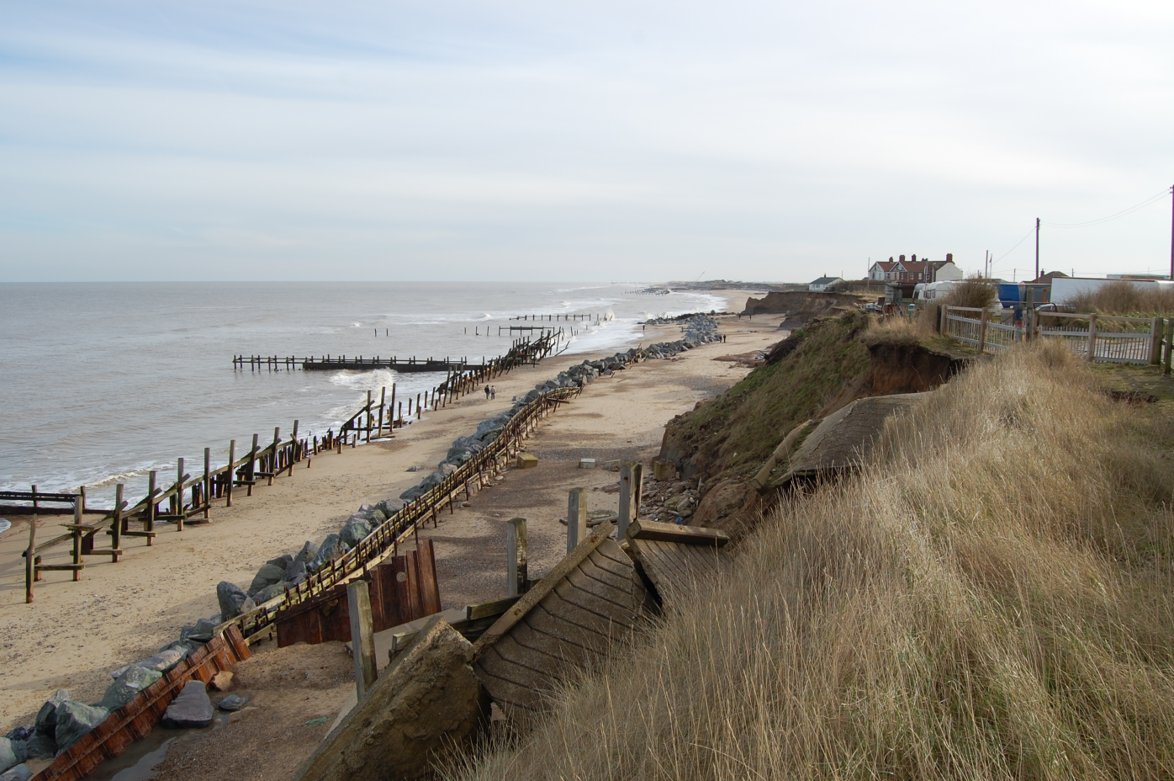
GCSE Geography Virtual Fieldcourse:- The Norfolk Coast
A Comparison of Coastal Management Strategies on the Norfolk Coast
Happisburgh:- Task 2
2

Slide 36
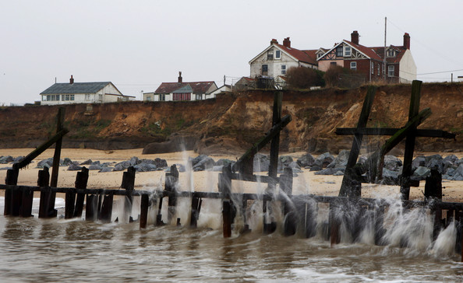
GCSE Geography Virtual Fieldcourse:- The Norfolk Coast
A Comparison of Coastal Management Strategies on the Norfolk Coast
Happisburgh:- Task 2
3

Slide 37
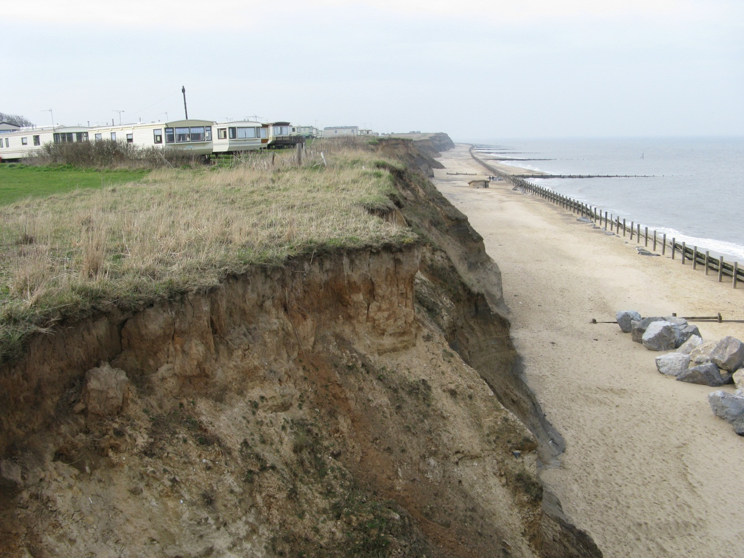
GCSE Geography Virtual Fieldcourse:- The Norfolk Coast
A Comparison of Coastal Management Strategies on the Norfolk Coast
Happisburgh:- Task 2
4

Slide 38
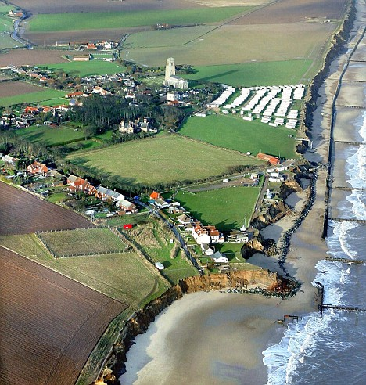
GCSE Geography Virtual Fieldcourse:- The Norfolk Coast
Fieldwork Location 1
Happisburgh:- Task 3
Complete Question 2 in your booklet by describing all the different types of management that has been used at Happisburgh.
Try to include what you think was the aim of the coastal management – why did they do it?

Slide 39
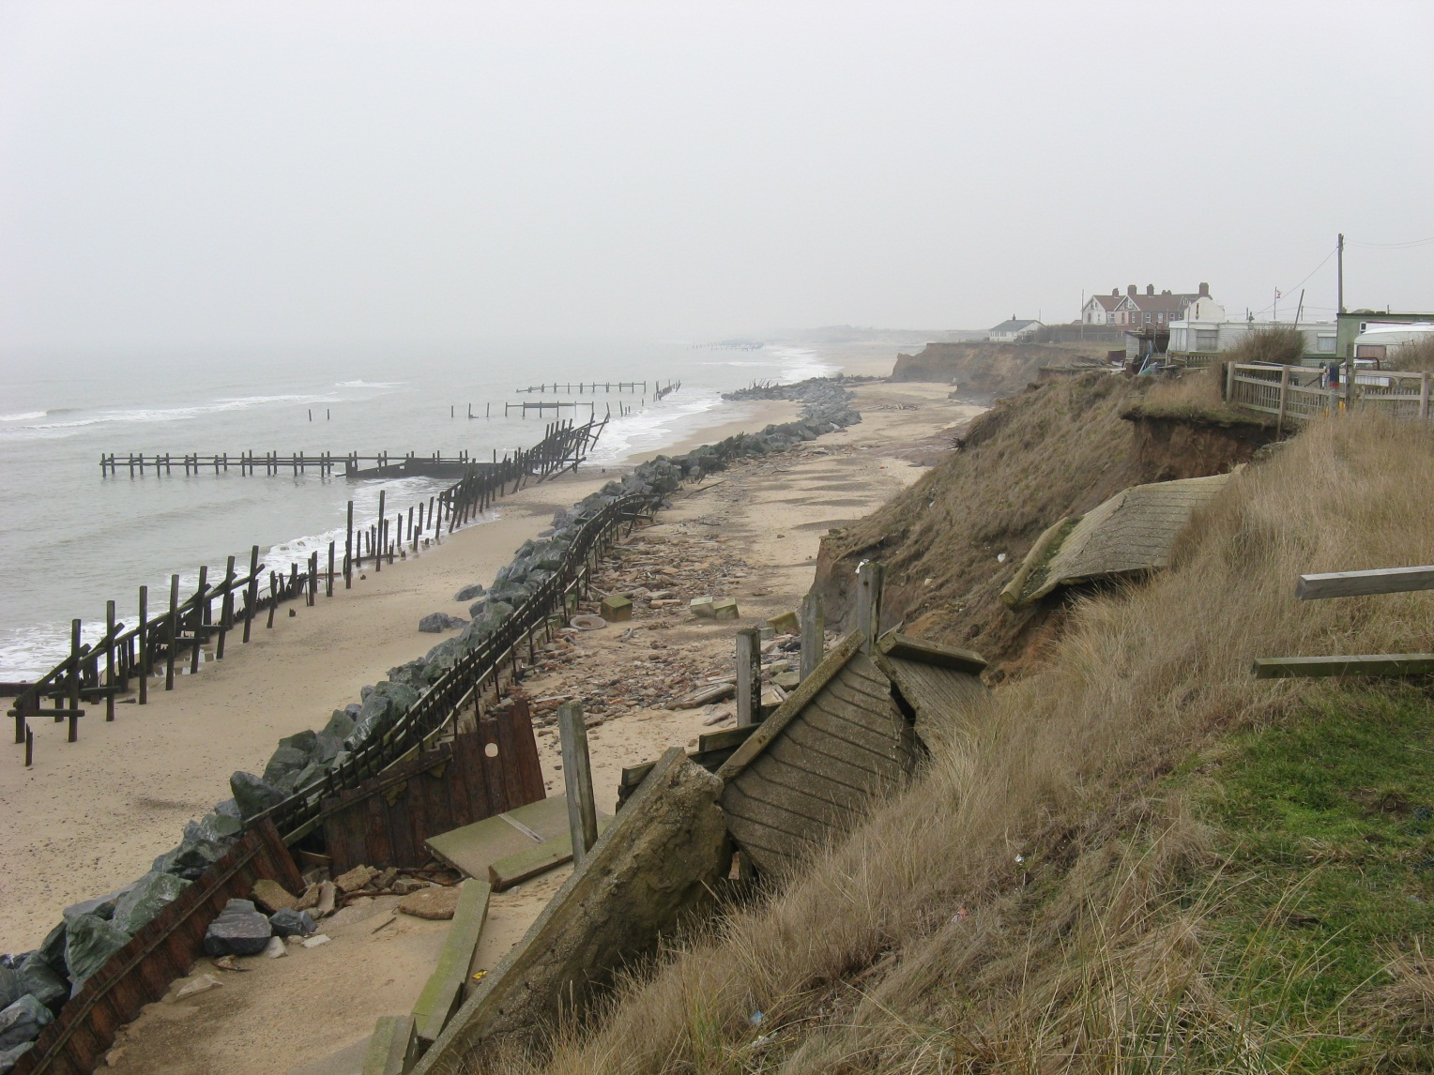
GCSE Geography Virtual Fieldcourse:- The Norfolk Coast
Fieldwork Location 1
Happisburgh:- Task 4
Has the management strategy been a success or failure?
Complete Question 4 in your booklet to help you make a decision.

Slide 40
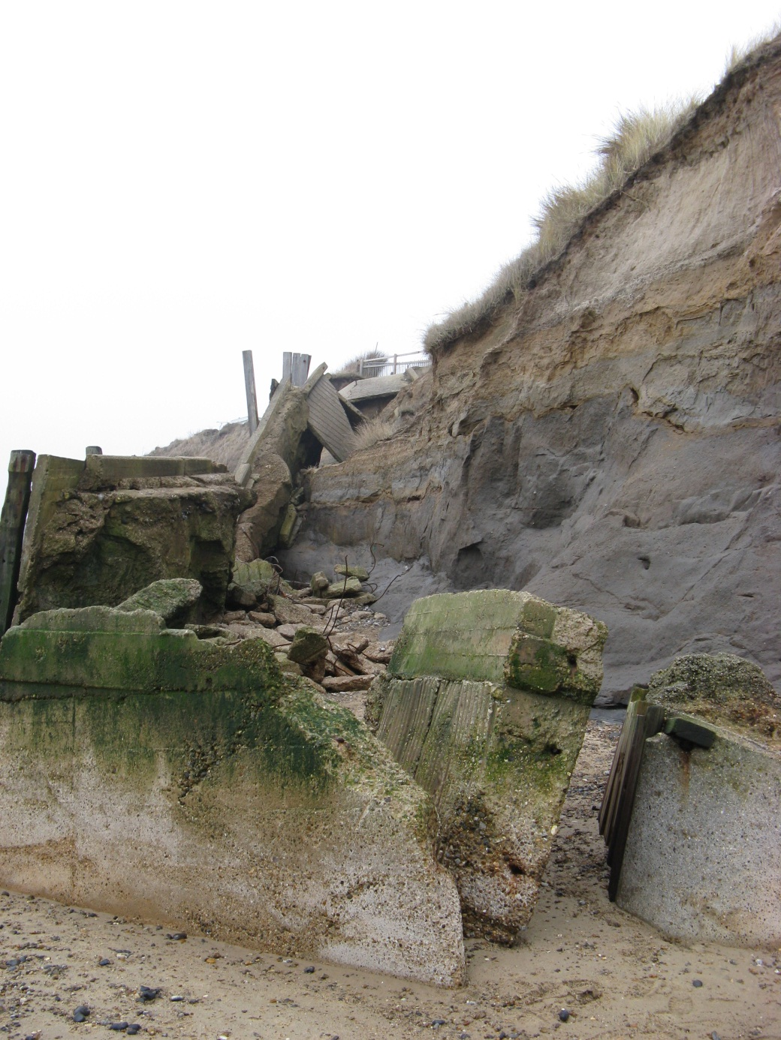
GCSE Geography Virtual Fieldcourse:- The Norfolk Coast
Fieldwork Location 1
Happisburgh:- Task 4
Has the management strategy been a success or failure?
Complete Question 4 in your booklet to help you make a decision.

Slide 41
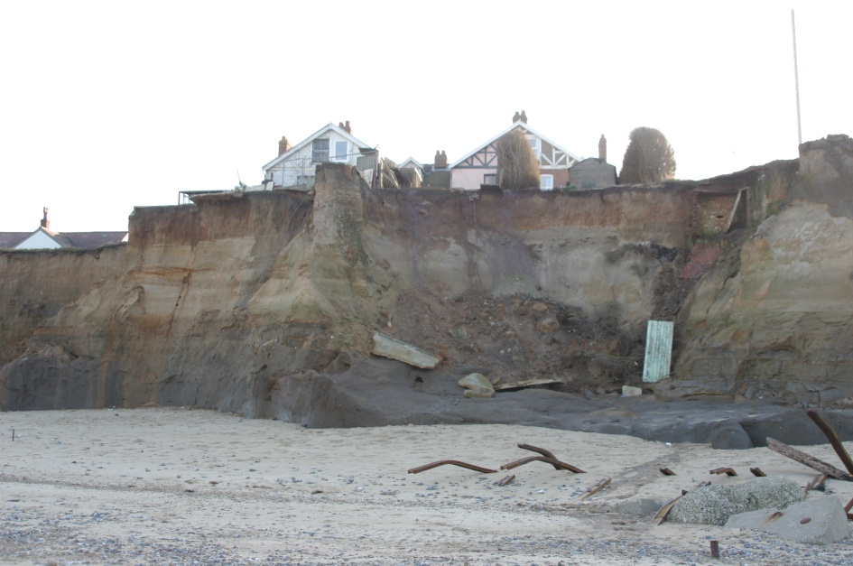
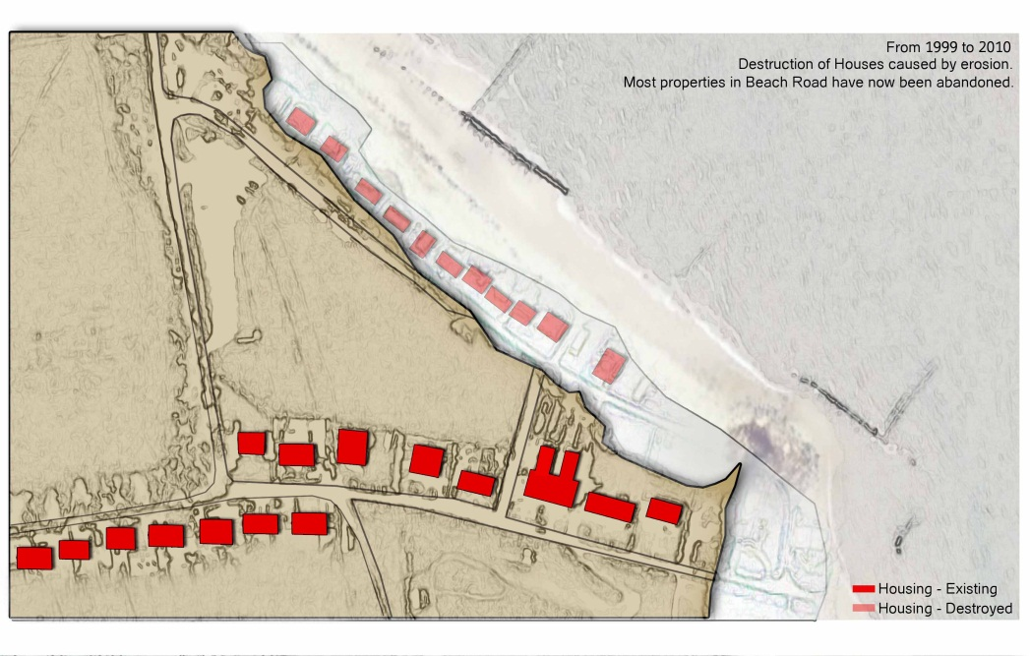
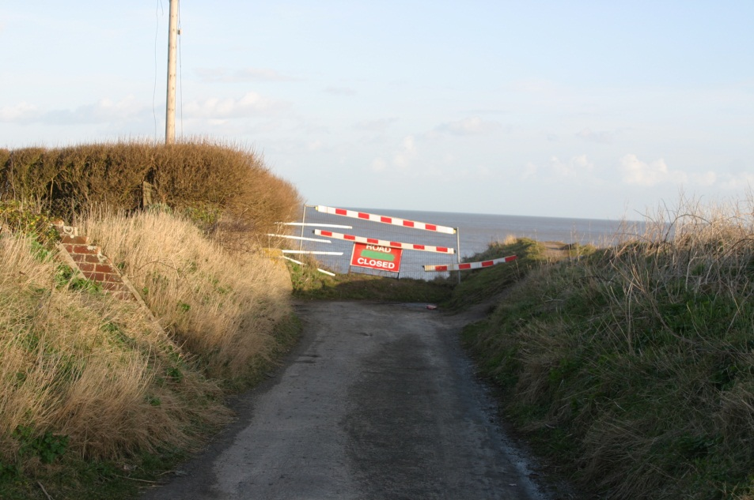
GCSE Geography Virtual Fieldcourse:- The Norfolk Coast
Fieldwork Location 1
Happisburgh:- Task 4
Has the management strategy been a success or failure?

Slide 42
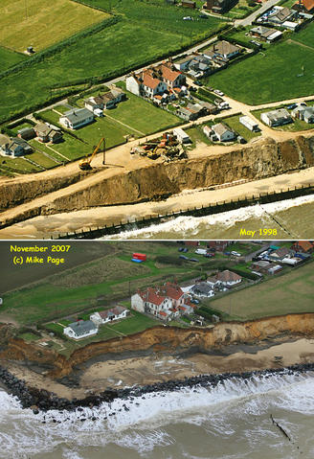
West Hatch High School Geography Department:- GCSE Geography Fieldcourse
A Comparison of Coastal Management Strategies on the Norfolk Coast
Happisburgh:- Task 4
Has the management strategy been a success or failure?

Slide 43
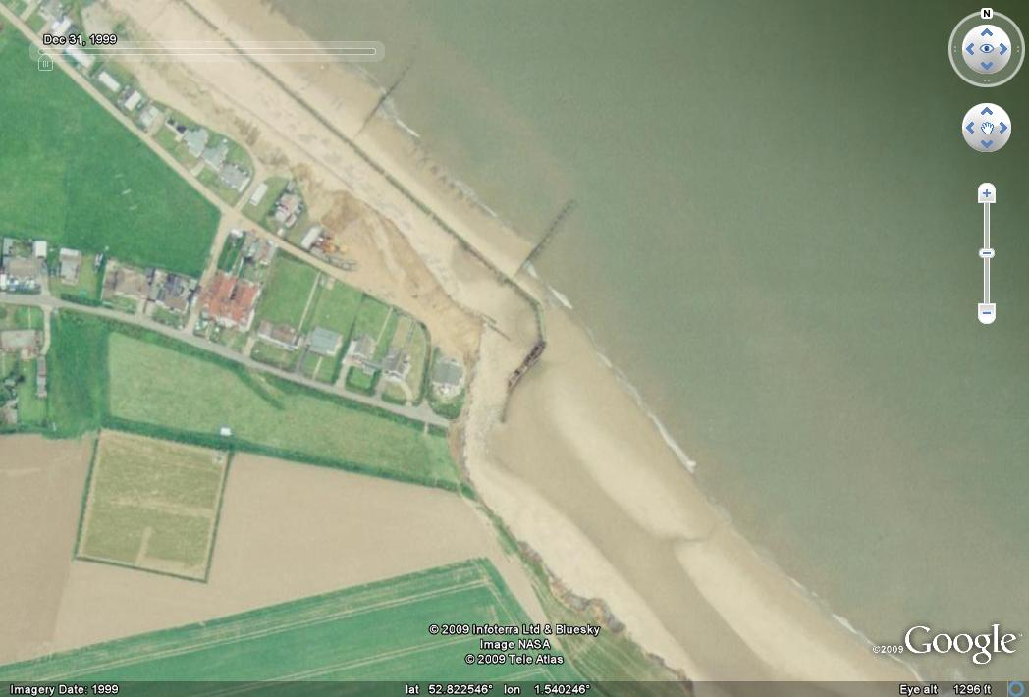
Happisburgh:- Task 4
Happisburgh 1999

Slide 44
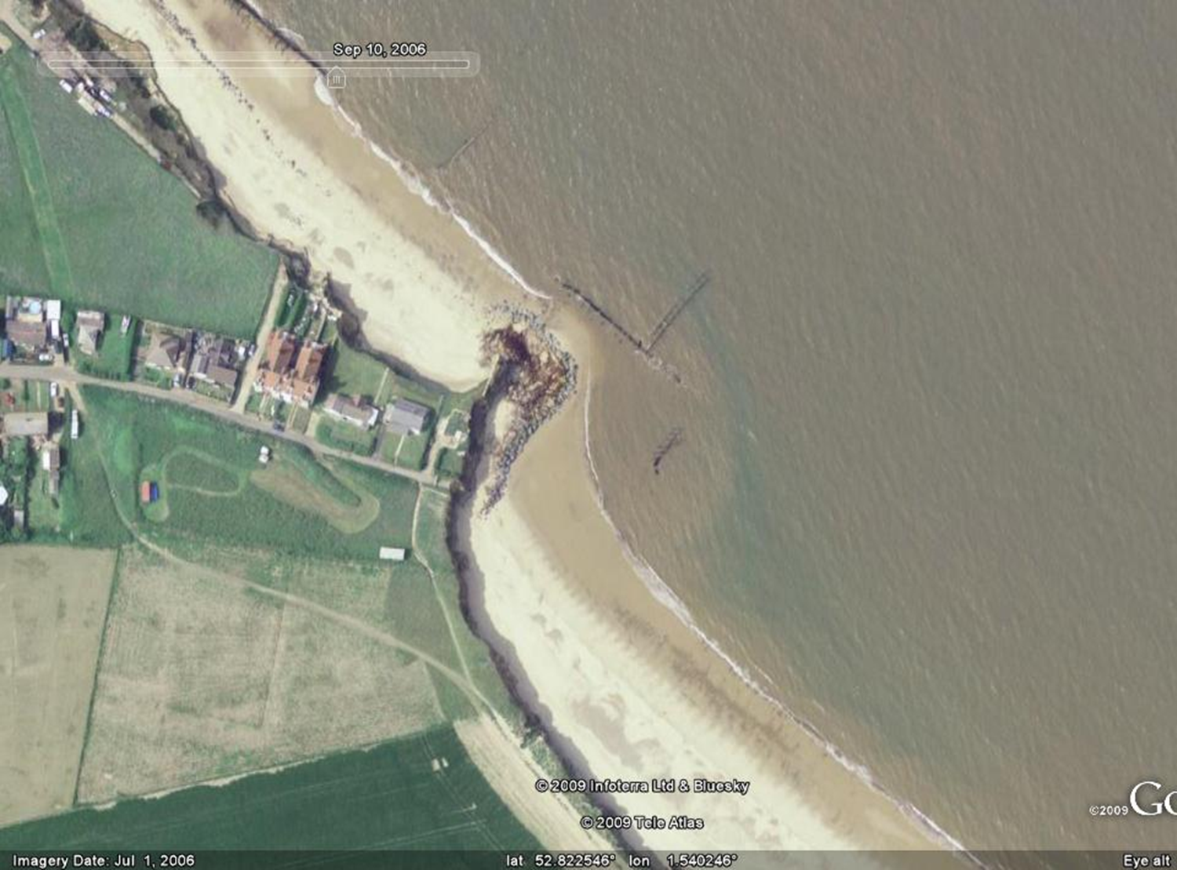
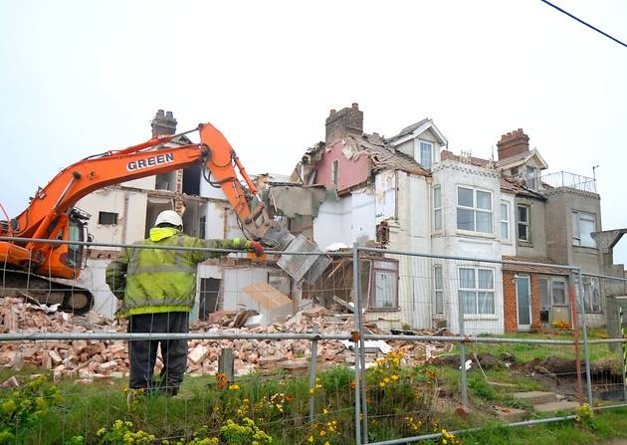
Happisburgh:- Task 4
Happisburgh September 2006
The remaining houses were demolished in April and May 2012

Slide 45
GCSE Geography Virtual Fieldcourse:- The Norfolk Coast
A Comparison of Coastal Management Strategies on the Norfolk Coast
Happisburgh:- Task 4
Steps giving access to the beach
2010
2012
September 2012
Removed by the council for safety

Slide 46
GCSE Geography Virtual Fieldcourse:- The Norfolk Coast
A Comparison of Coastal Management Strategies on the Norfolk Coast
Happisburgh:- Task 4
Beach access replaced by a sand ramp.
This was protected by bags of sand…
www.stacey.peak-media.co.uk/

Slide 47
GCSE Geography Virtual Fieldcourse:- The Norfolk Coast
A Comparison of Coastal Management Strategies on the Norfolk Coast
Happisburgh:- Task 4
….which were quickly broken by the sea!
www.stacey.peak-media.co.uk/

Slide 48
GCSE Geography Virtual Fieldcourse:- The Norfolk Coast
Fieldwork Location 1
Happisburgh:- Task 5
Another way of deciding how effective the management has been, is to evaluate what sort of impact it has had on the environment.
Using all the evidence you have seen, complete the following table which you will find in Question 5 in your booklet.

Slide 49
GCSE Geography Virtual Fieldcourse:- The Norfolk Coast
Fieldwork Location 1
Happisburgh:- Task 6
The effectiveness can also be evaluated by looking to see if the management is sustainable. Sustainable management would be successful but have minimum negative impact on the environment.
Using all the evidence you have seen, complete the following table which you will find in Question 6.

Slide 50
GCSE Geography Virtual Fieldcourse:- The Norfolk Coast
Fieldwork Location 1
Happisburgh:- Tasks 7 & 8
Evidence of longshore drift and description of the waves
Question 7.
This requires a highly skilled geographer using some high-tech equipment!
A float was thrown into the sea and timed for ten minutes to see how far it moved due to longshore drift.
RESULT - 30 metres. Direction = North West
Question 8
There were more than 13 waves in a minute.
Use the picture on the left to decide the height of the waves and how the waves break onto the beach.

Slide 51
GCSE Geography Virtual Fieldcourse:- The Norfolk Coast
Fieldwork Location 1
Happisburgh:- Task 9
Question 9 in the booklet.
Study the pictures below and complete the table.

Slide 52
GCSE Geography Virtual Fieldcourse:- The Norfolk Coast
A Comparison of Coastal Management Strategies on the Norfolk Coast
REMEMBER…

Slide 53
GCSE Geography Virtual Fieldcourse:- The Norfolk Coast
A Comparison of Coastal Management Strategies on the Norfolk Coast
REMEMBER…
Fieldwork could be completed when the conditions were very different

Slide 54
GCSE Geography Virtual Fieldcourse:- The Norfolk Coast
A Comparison of Coastal Management Strategies on the Norfolk Coast
REMEMBER…
Features can change very quickly – make sure you research up to date information, especially about Happisburgh
11th April 2012
10th May 2012

Slide 55
GCSE Geography Virtual Fieldcourse:- The Norfolk Coast
A Comparison of Coastal Management Strategies on the Norfolk Coast
REMEMBER…
There is a vast amount of information available. Maps, diagrams, graphs etc. must all be prepared before the controlled part of the assessment begins.

